Slide 1
THINK Before You Post Online
Brought to you by Commonsense.org and Mr. Theune

Slide 2
Social Media: More than your friends Today We Will Learn:
Why do people use social media?
Why it’s important to post thoughtfully
How to prevent oversharing

Slide 3
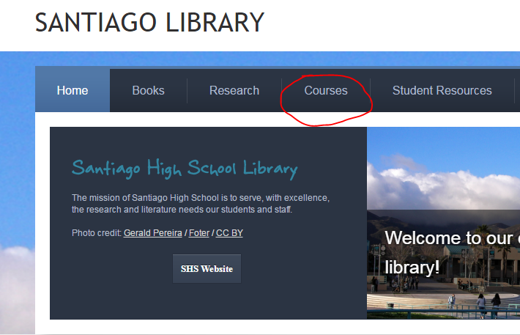
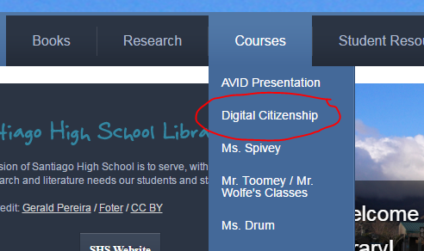
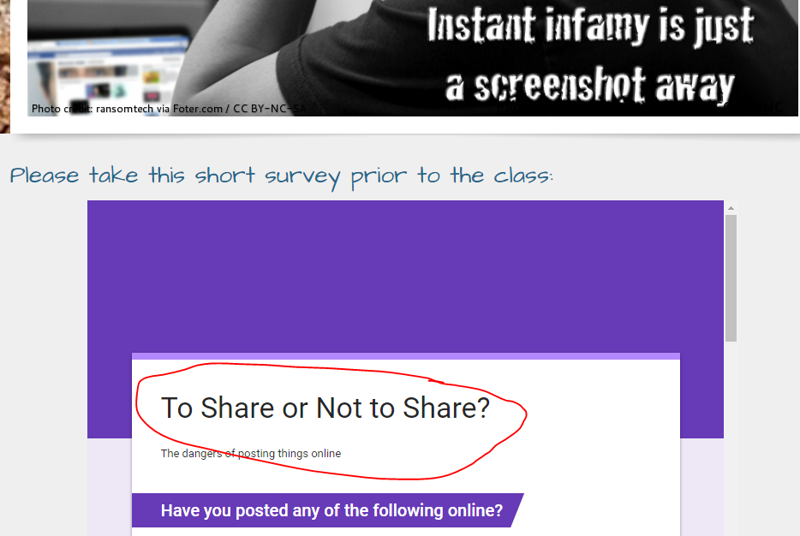
Social Media: More than your friends Before we begin please:
Go to: unlimitedlibrarian.com
Please click on “Courses” and “Digital Citizenship
Please take the short survey

Slide 4
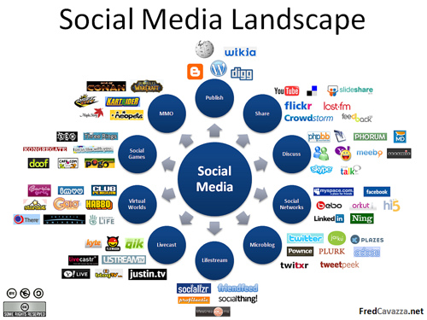
Social Media: More than your friends What are the benefits of sharing?
What are some examples of people sharing in a rewarding way?
Share positive information or solve problems
Produce videos or photo albums
Video chat with friends who are far away

Slide 5
Social Media: More than your friends Imagine if your social network photos were broadcast on a popular talk show:

Slide 6
Social Media: More than your friends Take a moment to answer this question: Who can see you on Facebook?
Friends
Parents
Teachers
Potential Employers

Slide 7
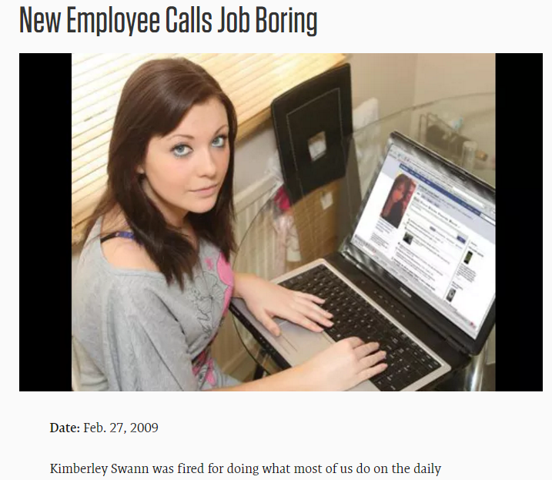
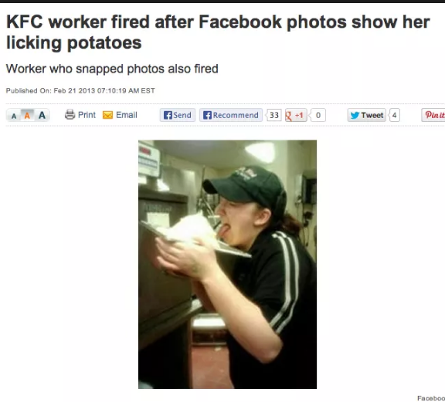
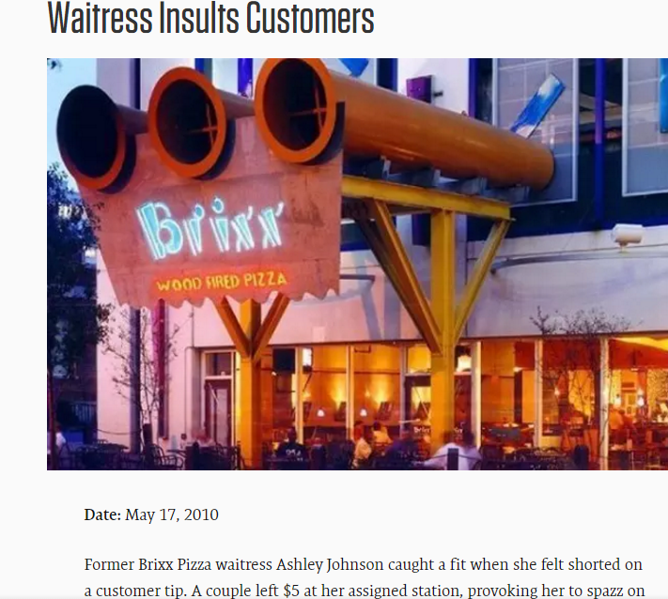
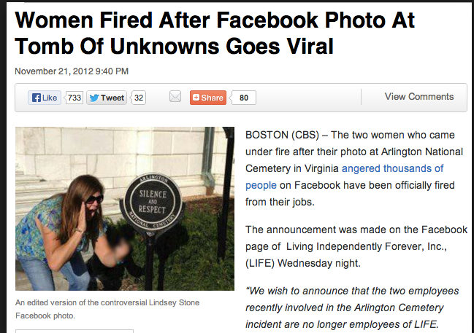
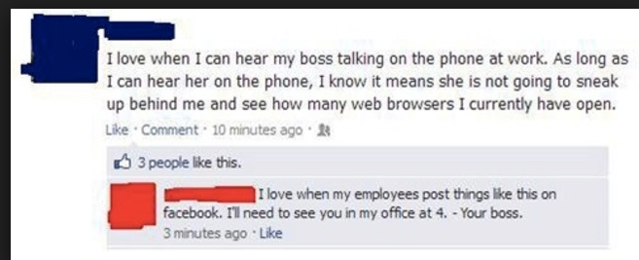
Social Media: More than your friends Anything you “overshare” on social media can damage your future

Slide 8
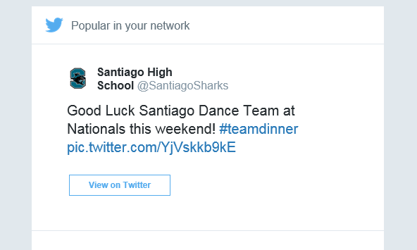
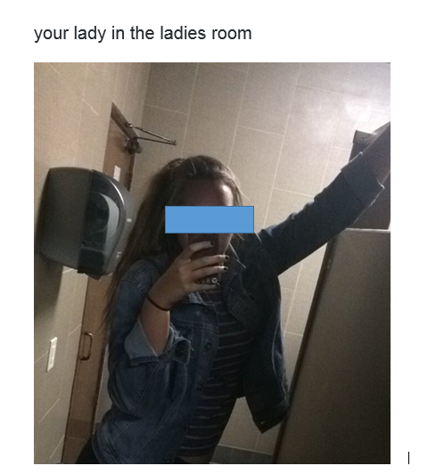
Social Media: More than your friends It happens on our SHS Twitter Feed: Most information posted online…
Can be searched
Can be seen by HUGE, invisible audiences
Can be copied, altered, and sent to others
Is persistent-it’s impossible to take down as it can start to spread the minute it is posted

Slide 9
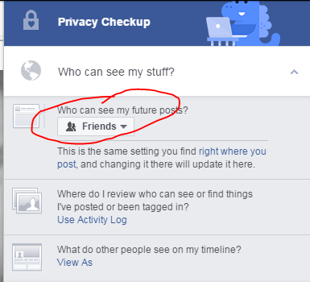
Social Media: More than your friends Consider any social media public because:
“Private” information can become public if passed on
What about “Snap Chat” or “Self Destruct” apps?
Posts in many online communities are public by default

Slide 10
Social Media: More than your friends Brittney’s Story

Slide 11
Social Media: More than your friends Brittney’s Story: Questions
Why do you think Brittney and her friends wanted to broadcast themselves?
In what ways did Brittney’s actions impact her later?

Slide 12
Social Media: More than your friends What are the positives and negatives of sharing information online?
Go back to the library website and enter the following three items on the “Padlet”:
What is a positive example of sharing information online?
What is a negative example of sharing information online?
What is one thing you can do to minimize oversharing in your life?

Slide 13
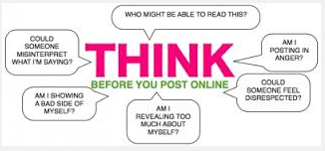
Social Media: More than your friends How can you prevent oversharing?
Don’t share secrets, embarrassing stories, or damaging information about self or others
Set privacy controls
Thoughtfully manage a positive digital footprint

Slide 14
Finally, go back to the library website and take the short quiz: The Consequences of Oversharing

