Slide 1
Social Networks: Be Aware of Who is Out There
Brought to you by Mr. Theune and Commonsensemedia.org

Slide 2
Online Security and Privacy What if a stranger?
Asked for your name and age?
Knew your favorite snack or TV show?
Overheard your private conversations
Followed you around all day?
Read your emails and instant messages
Looked into your room?
Knew your phone number and home address

Slide 3
The Strangers:

Slide 4
Social Networking: Types of Services
Networking:
Facebook, Google+, Linkedin, Twitter, Instagram, Snapchat
Content Sharing:
Pinterest, Facebook, Dropbox, Google Drive, Instagram
Location-based Services
Foursquare, Google Latitude, Facebook, Gowalla

Slide 5
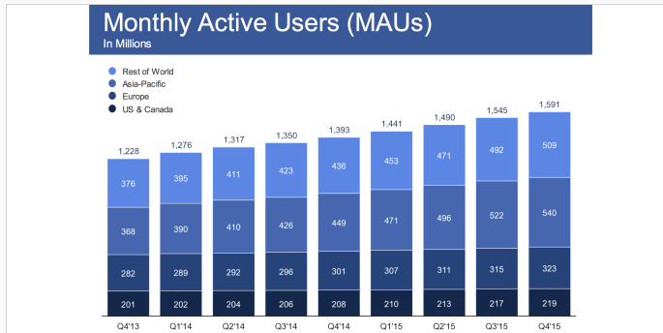
Why is it free? Marketing and Advertising
Facebook has 1.5 Billion monthly active users
Revenues for Q4 of 2015 = 5.8 Billion
Linkedin Marketing Solutions: 861 Million

Slide 6
Question:
Do you think Social network sites use targeting and tracking to sell you things?

Slide 7
Social Networking: Husband sees wife on Facebook Dating Ad

Slide 8
Take a moment to answer this question: Who can see you on Facebook?
Friends
Parents
Teachers
Potential Employers
Internet Predators
The Government
Internet Predators
Answer:
Your Privacy settings affect who can see your posts on social media
Additionally- Once it’s on the internet-it stays on the internet

Slide 9
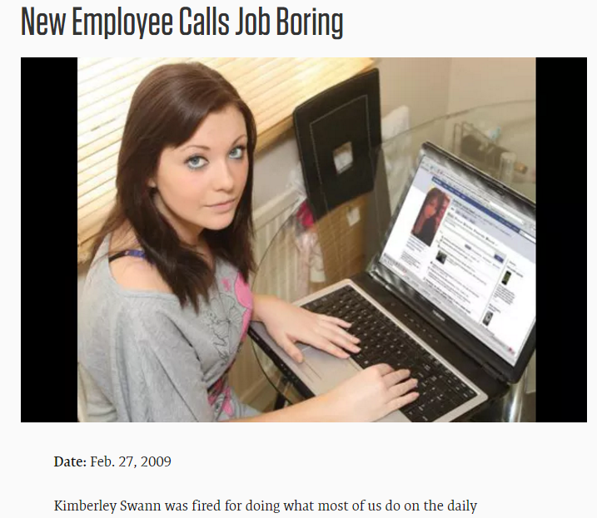
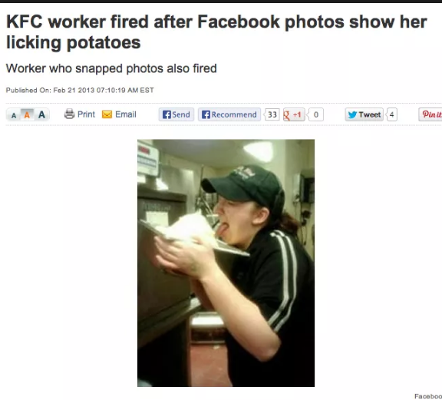
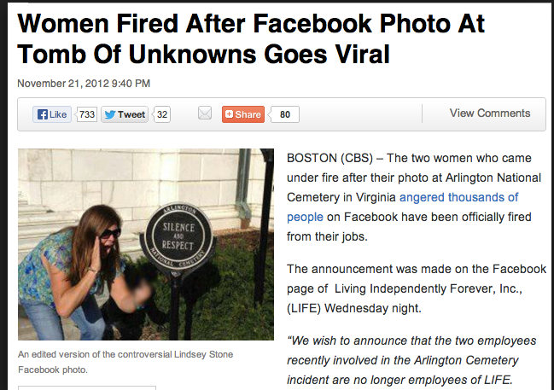
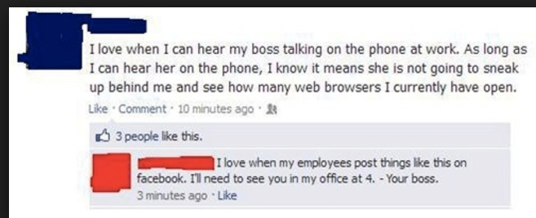
Anything you share on social media can damage your future

Slide 10
How to increase the privacy settings on Facebook

Slide 11
How to increase the privacy settings on Facebook
Let’s take some time to increase the privacy settings on our social media accounts

Slide 12
General Tips for Using Social Networks:
Become familiar with the privacy settings on your social networks
Don’t share your birthday, age or place of birth (useful for identity thieves)
Don’t post your address, phone number or email address
Delete cookies every time you leave a social networking site
Don’t publicize vacation plans-especially the dates you’ll be gone
Don’t make public where your home is located
Be sure to log off from social networking sites when you no longer need to be connected

