Slide 1
Private Today, Public Tomorrow: How can you respect the privacy of others online?
Brought to you by Mr. Theune with tons of help from Common Sense Media

Slide 2
Sharing information online:
What are the benefits and risks of sharing information online?
Why is context in posting or viewing online images important?
What choices do you need to make to protect the privacy of others online?

Slide 3
What are the benefits and risks of sharing information online?
Can you name three reasons to share information online?
Can you name three things that could go wrong when you share things online?
What can be posted that is good for your reputation?
What can be posted that is harmful?

Slide 4
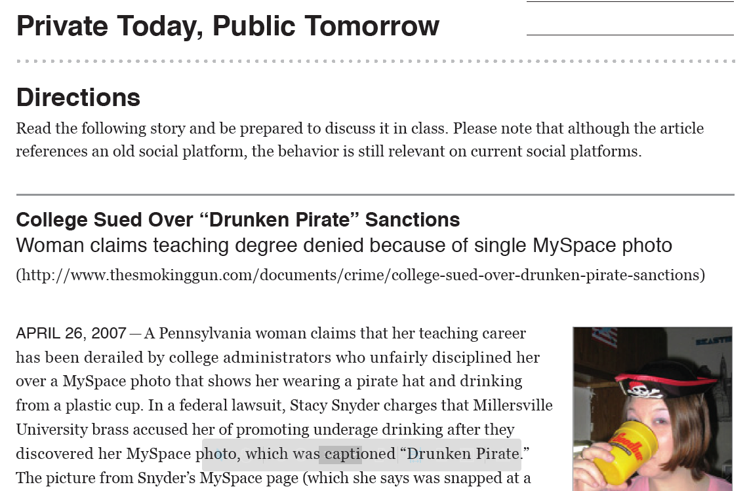
Example: Teacher in Training
The Unintended Consequences of Sharing:
Read over the article and discuss the following questions in your groups

Slide 5
Example: Teacher in Training
Do you think Millersville University was justified in disqualifying Stacy from earning her teaching degree because of her profile page? Why or why not?
How would the situation be different if the context of the photo were different? If the caption said “Happy Halloween” or “My friend forced me to wear this hat?”

Slide 6
Example: Teacher in Training
What if Stacy’s friend Joe has posted it without her knowing it and tagged her with the “Drunken Pirate” caption? Does the fact that Joe posted the picture change the situation? Why or why not?
Does Joe have a responsibility to ask Stacy before he posts (and tags) a picture of her? Do other people that want to repost or tag the photo have a responsibility to check with her? Why or why not?

Slide 7
Think about your own life:
Do you ever post things online about your friends? Do you comment on or tag their posts or photos? How do you decide what is okay?
What if your own judgment about a post is different from a friend’s?
For example: You’ve posted a photo of a group of friends, everyone loves it but one member doesn’t like the way he looks and asks that you take it down. What do you do?

Slide 8
Respect and Boundaries Scenarios:
Snooping:
Nadia was at lunch with her friends, but when she ran to the bathroom, she left her phone on the table. While she was gone, her friend Julie grabbed Nadia’s phone and started looking through her texts. The first text she saw was an angry one from Nadia’s mom because of a failing grade in math.
From: http://dlrp.berkman.harvard.edu/node/85

Slide 9
Respect and Boundaries Scenarios:
Snooping:
How would that make Nadia feel?
Why would Nadia not want to tell her friends about her bad grade?
Were Julie’s actions acceptable?
How would the other friends at the lunch table feel about Julie’s actions?
What do you think about Julie? Was she acting ethically? Would you want to be friends with Julie?
From: http://dlrp.berkman.harvard.edu/node/85

Slide 10
Respect and Boundaries Scenarios:
Photo Sharing:
Rodrigo is talking to Caitlin when he trips and falls into the mud. Caitlin thinks he looks really funny and takes a picture of him, but Rodrigo doesn’t laugh and feels embarrassed.
From: http://dlrp.berkman.harvard.edu/node/85

Slide 11
Respect and Boundaries Scenarios:
Photo Sharing:
Why might Caitlin post the photo online?
Why is Rodrigo upset?
What do you think Rodrigo should say to Caitlin?
How would you feel if someone took an embarrassing picture of you? Would you want that online?
From: http://dlrp.berkman.harvard.edu/node/85

Slide 12
Respect and Boundaries Scenarios:
Information boundaries:
Ingrid is a 15-year-old student with two brothers, a mom and a lot of friends and classmates. She also has a teacher for every subject in school and sees a doctor every year for a check up. Her grades right now aren’t great, and last year she broke her leg doing something stupid, and she doesn’t want anyone else to find out. She also has a boyfriend from school, but her mom doesn’t know.
From: http://dlrp.berkman.harvard.edu/node/85

Slide 13
Respect and Boundaries Scenarios:
Information boundaries:
Who needs to know about her bad grades? Her medical history? Her boyfriend? Why?
Who might Ingrid want to talk to about any of these issues?
In your life, what are examples of information which you want your parents to see but not your friends, or vice versa?
From: http://dlrp.berkman.harvard.edu/node/85

