Slide 1
I’m Not Feeling Like Myself Today: Identity Theft and How to Prevent It
Brought to you by Mr. Theune and Commonsensemedia.org

Slide 2
What would a criminal need to do to:
Rob a Bank?
Shoplift?
Steal Someone’s Identity?

Slide 3
Online Security: What is it and why is it important?
Think about all of the things people do online:
Purchase items
Banking
Contact friends and work through email and social networks
If a crook finds out enough personal information about you, he/she can become you online

Slide 4
Identity Theft: The criminal steals your identifying information and contact info
Phishing: Phoney emails, messages and texts trying to trick people into giving out personal and financial information
Clickjacking: Using a “fake” webpage to get you to give out your personal information
Viruses and Spyware: Users download a computer program that takes collects information

Slide 5
Phishing: Phony emails, messages, texts, or links to fake websites that try to get you to give out personal information
Bank Scam:
You give the crooks your username and password
Do not click links
Misspellings?
Be suspicious of emails that as for information

Slide 6
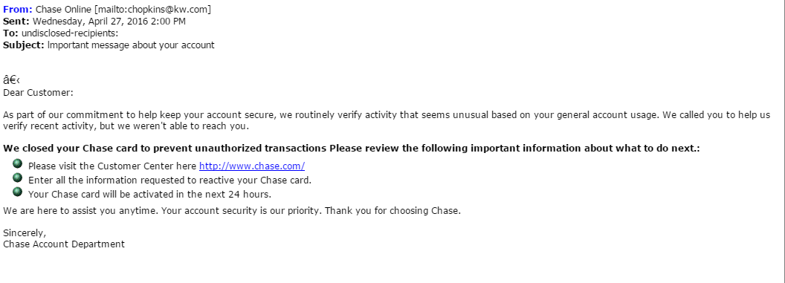
Example of Phishing: Chase Bank

Slide 7
Example of Phishing: Amazon

Slide 8
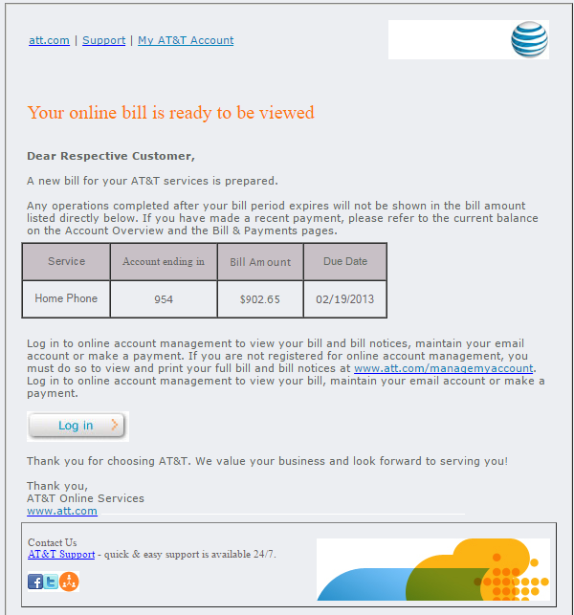
Example of Phishing: AT and T Bill

Slide 9
Phishing: It can happen in social media
Can you identify the indicators that this is a scam?

Slide 10
How to avoid the phishing scam:
Don’t click on links in your email!:
Go directly to the website:
For example, go to www.amazon.com
Then use that website to contact someone
Customer service through their phone number
There’s no reason to enter identifying information from an email link!

Slide 11
Spyware, Malware and Other stuff

Slide 12
Your first line of defense: Passwords
Why are passwords so difficult?

Slide 13
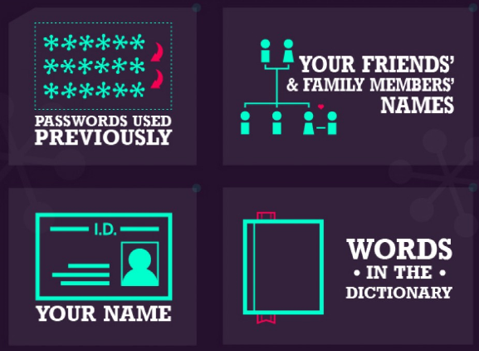
Some Characteristics of Weak Passwords:
From: http://visual.ly/how-strong-your-password

Slide 14
Some Characteristics of Weak Passwords:
From: http://visual.ly/how-strong-your-password

Slide 15
Websites that were hacked:
From: http://visual.ly/how-strong-your-password

Slide 16
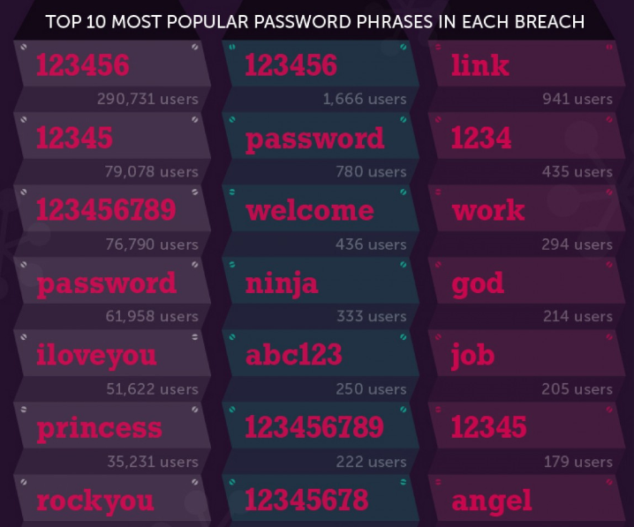
What were the most common passwords?
From: http://visual.ly/how-strong-your-password

Slide 17
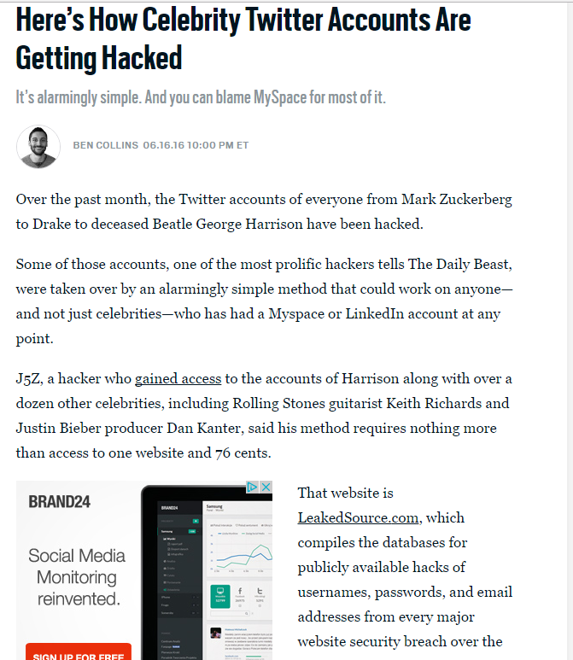
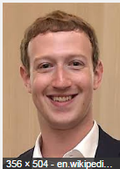
Everyone Gets Lazy

Slide 18
How long would it take a computer to crack your password?
From: http://visual.ly/how-strong-your-password

Slide 19
How long would it take a computer to crack your password?
From: http://visual.ly/how-strong-your-password

Slide 20
How long would it take a computer to crack your password?
From: http://visual.ly/how-strong-your-password

Slide 21
Password hints:
Do not use the same password for multiple sites or logins
Do not use your name or commonly known information or anything else that could easily be guessed or researched
Use combinations of upper and lower-case letters, along with numbers and special characters
Make the password as long as possible. Hackers use programs to guess your password, so the longer it takes them, the greater the chance that they will move on.

Slide 22
Another Option: A Password Manager
What is a password manager? From Wikipedia: A password manager is a software application that helps a user store and organize passwords. Password managers usually store passwords encrypted, requiring the user to create a master password: a single, ideally very strong password which grants the user access to their entire password database.
Some examples include: 1Password, Passwordwallet4 and Dashlane

Slide 23
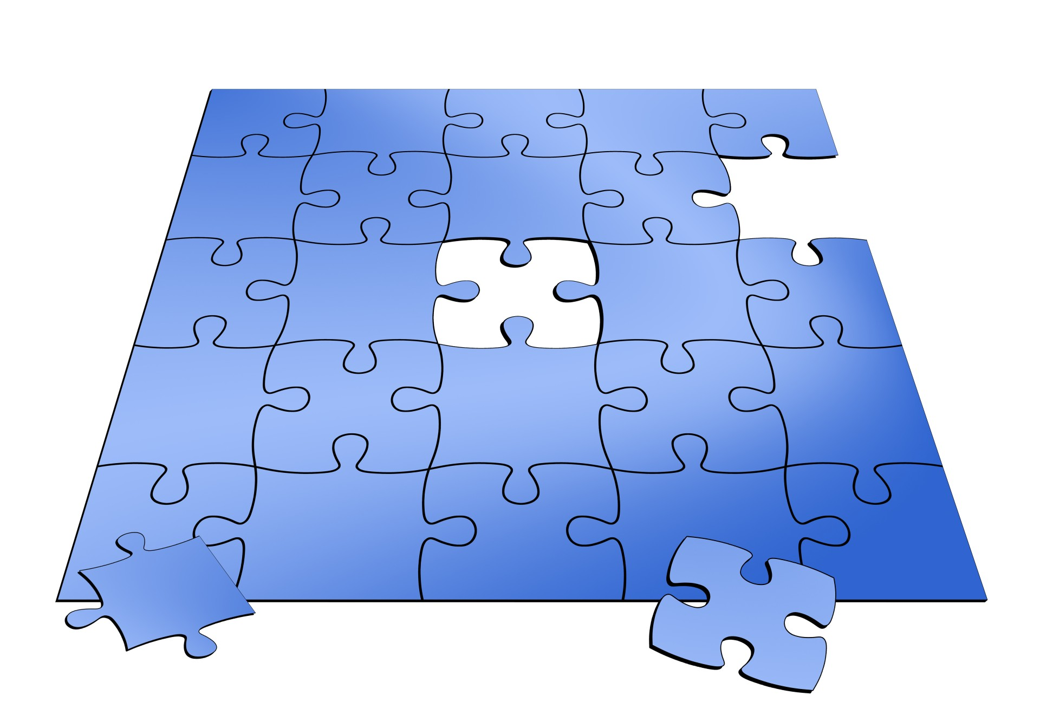
Finally: Keep in mind that criminals are trying to put together your online puzzle
Your online information is a puzzle: If hackers put together enough pieces the prize is your financial accounts
Make it as difficult as possible:
For example: Security questions:
Answer the questions incorrectly
Where did you go to school? Harvard!
Think about “Freezing your credit”:
http://www.clark.com/credit-freeze-and-thaw-guide

