Slide 1
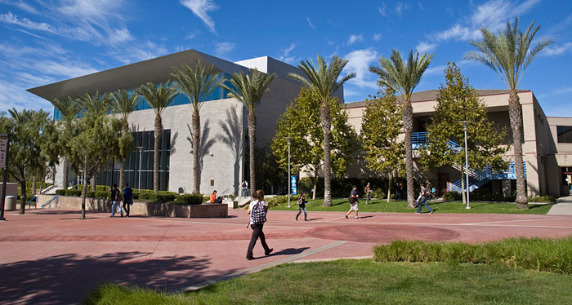
Financial Aid 101
Presented by Victor Castro
Santiago Canyon College
High School & Community Outreach
castro_victor@sccollege.edu
outreach@sccollege.edu
714.628.4808
www.sccollege.edu
outreach@sccollege.edu

Slide 2


Santiago Canyon College
Ranked 13th best
Community College
In the nation by
College Choice
2017
www.sccollege.edu/apply
Accepting fall 2019
Applications Oct. 1st, 2018

Slide 3
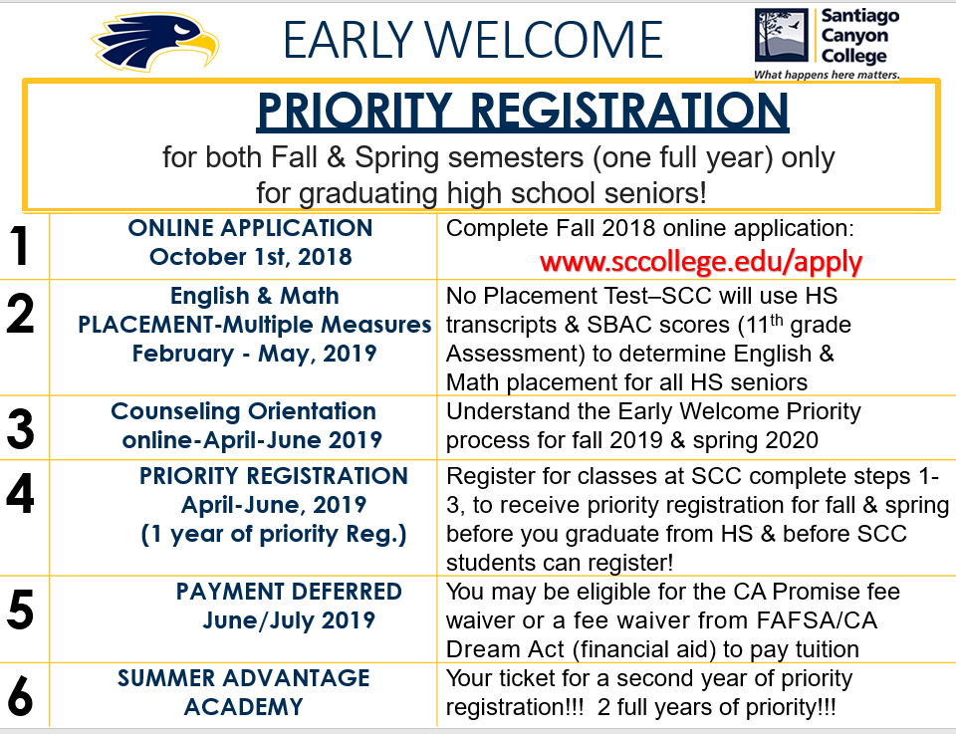

Slide 4

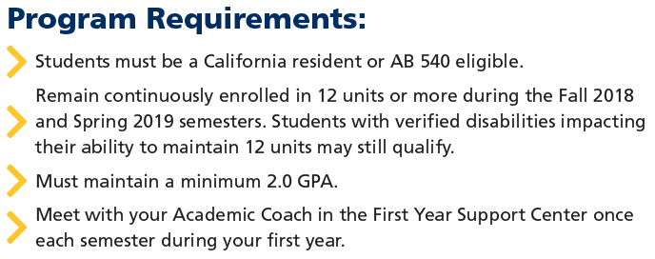
SCC Early Welcome
Steps:
Apply October 1st, 2018 – April 2019
Attend Counseling Orientation & Registration for fall 2019 in April/May
Apply for FAFSA or Cal Dream Act
All 2019 high school graduates are eligible to receive the SCC Promise of free tuition for the first year.
Students that have financial need, (determined by the FAFSA), may also be awarded a $400 book voucher to the SCC Hawk Bookstore ($200 for fall and spring semesters).
www.sccollege.edu/apply

Slide 5
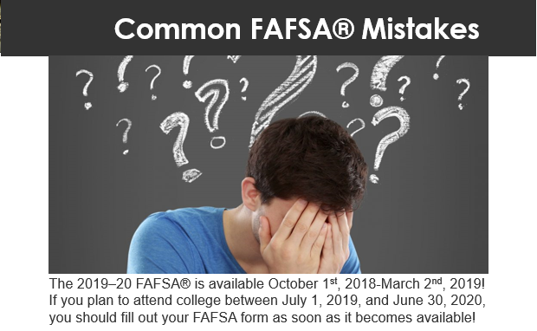
The 2019–20 FAFSA® is available October 1st, 2018-March 2nd, 2019! If you plan to attend college between July 1, 2019, and June 30, 2020, you should fill out your FAFSA form as soon as it becomes available!

Slide 6
Just make sure you don’t make one of these common mistakes:
1. Not Completing the FAFSA Form
I hear all kinds of reasons: “The FAFSA form is too hard.” “It takes too long to complete.” “I’ll never qualify anyway, so why does it matter?” It does matter! When it comes to Federal Student Aid the (FAFSA) form is not just the application for federal grants such as the Federal Pell Grant, it’s also the application for Federal Work-Study funds, Federal Student Loans, and even Scholarships and Grants offered by your state, school, or private organization. If you don’t complete the FAFSA form, you could lose out on thousands of dollars to help you pay for college. It takes little time to complete, and there are “Help and Hints” provided throughout the application.
2. Not Using the Correct Website
The official FAFSA website is fafsa.gov. That’s “.gov”! You never have to pay to complete the FAFSA form. If you’re asked to provide credit card information, you’re not on the official government website.

Slide 7
3. Not Filling Out the FAFSA Form as Soon as It’s Available
If you want to get the most financial aid possible, fill out the FAFSA form ASAP. Some financial aid is awarded on a first-come, first-served basis, and some states and colleges run out of money early. Even if it seems like your school’s deadline is
far off in the future, get your FAFSA form done ASAP. The 2019–2020 FAFSA form requires 2017 tax information, which you should have, so no excuse to wait!
4. Not Filing the FAFSA Form by the Deadline:
When to Apply: October 1st to March 2nd (every year for the next 4 years)
5. Not Getting an FSA ID Before Filling Out the FAFSA Form
It’s important to get an FSA ID before filling out the FAFSA form. Why? Well, because when you register for an FSA ID, you may need to wait up to three days before you can use it to sign your FAFSA form electronically. An FSA ID is a username and password used to log in to certain U.S. Department of Education websites, including fafsa.gov. You AND one parent (if you’re considered a dependent student) will each need your own, separate FSA IDs if you both want to sign your FAFSA form online. DO NOT share your FSA IDs with each other!
Don’t wait! Create an FSA ID now: Studentaid.gov/fsaid.

Slide 8
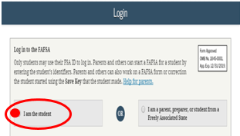
6. Not Using Your FSA ID to Start the FAFSA Form
When you go to fafsa.gov, you will be given two options to log in:
1) Enter your (the student’s) FSA ID username and password
2) Enter the student’s information
If you’re the student, you should choose the first option. Why? When you do, some of your personal information (name, Social Security number, date of birth, etc.) will be automatically loaded into your application. This will prevent you from running into a common error that occurs when your verified FSA ID information doesn’t match the information on your FAFSA form. Also, you won’t have to enter your FSA ID again to transfer your information from the IRS or to sign your FAFSA form electronically.
1.
2.

Slide 9
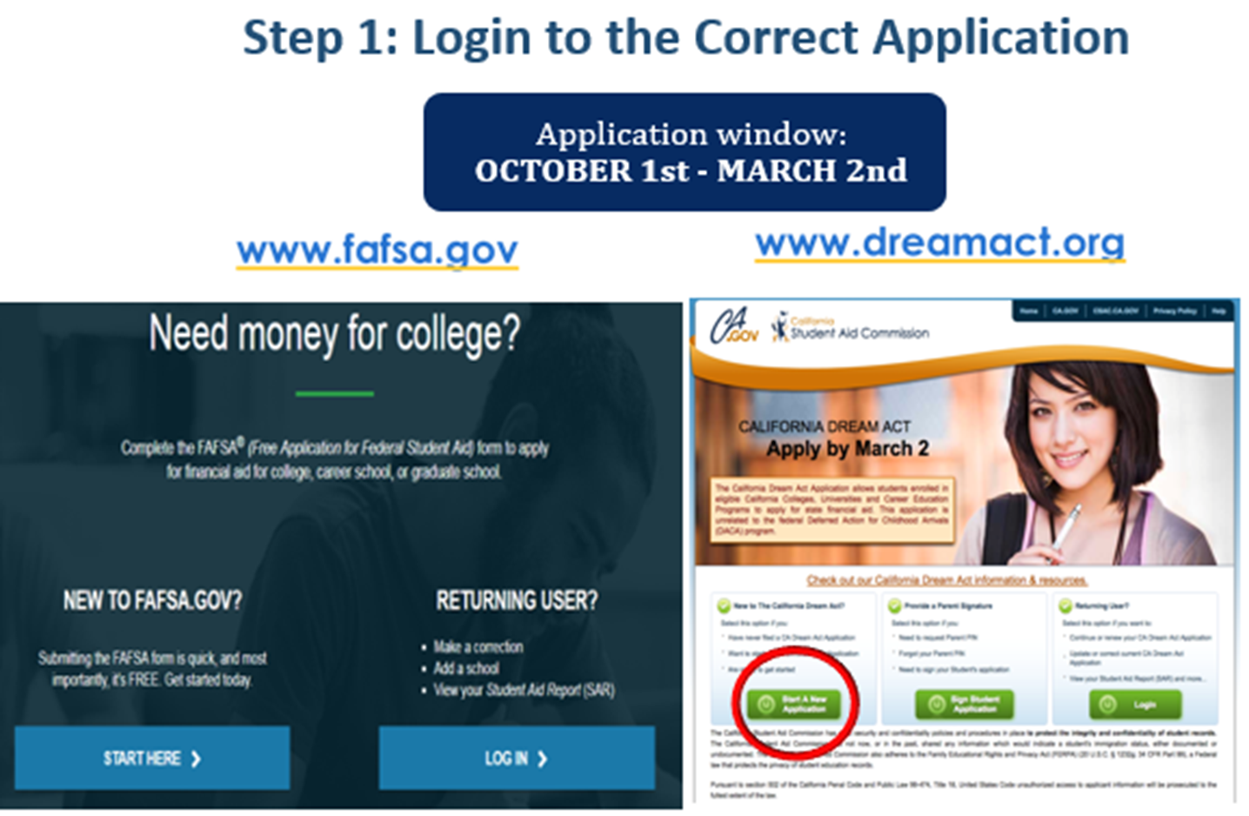
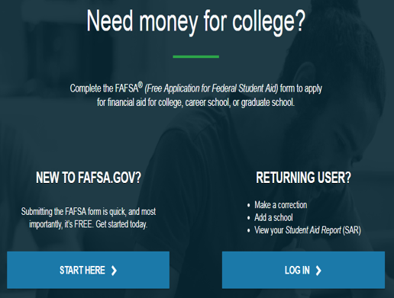

Slide 10

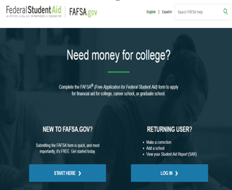
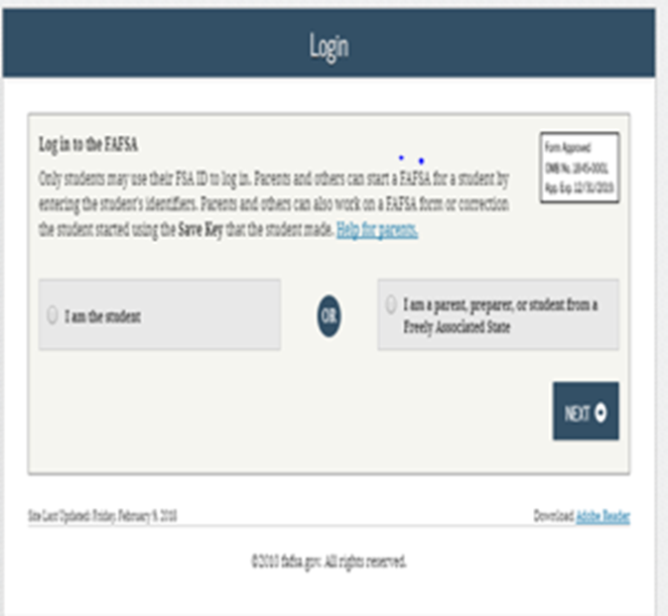
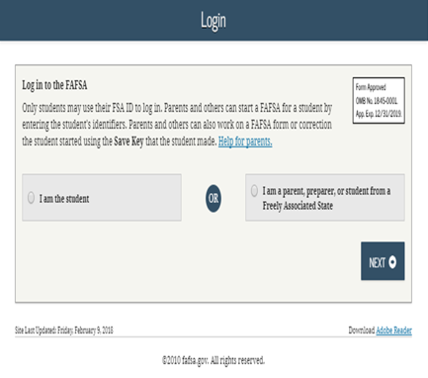
FAFSA STEPS

Slide 11
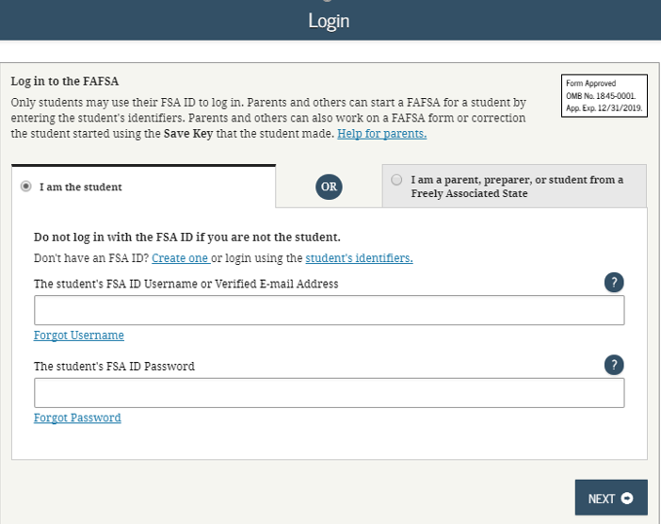
Create the FSA ID

Slide 12
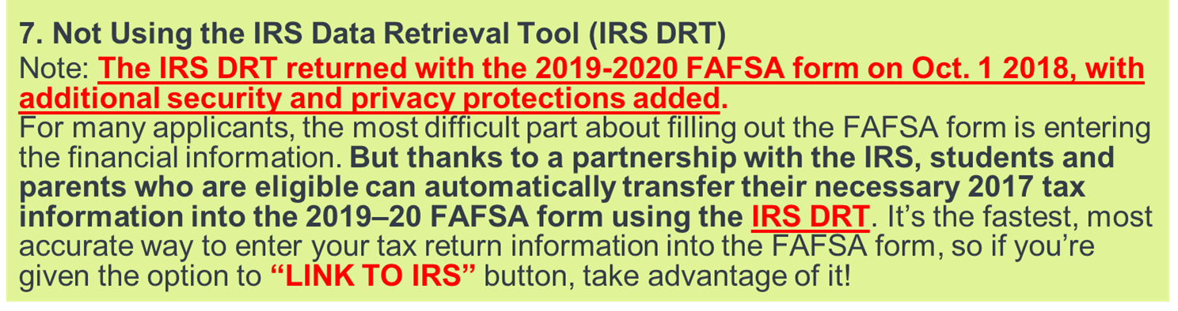
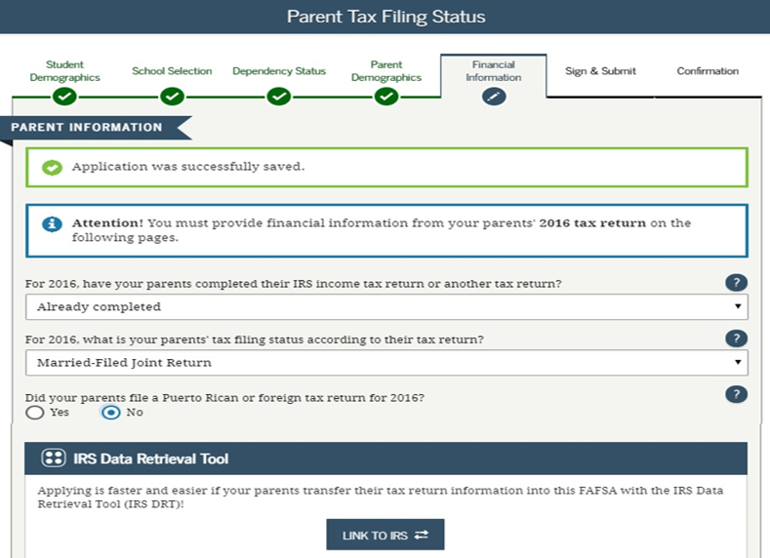


Slide 13
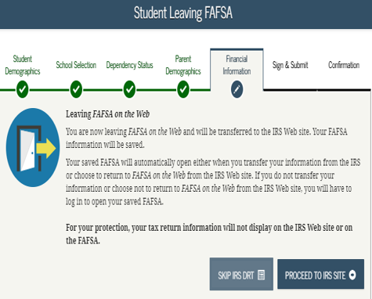
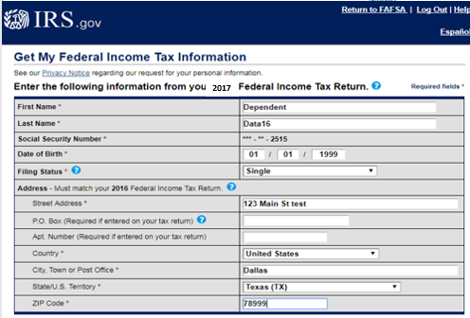
Go from
FAFSA
To IRS
Website

Slide 14
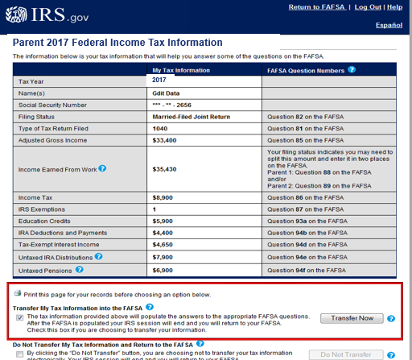
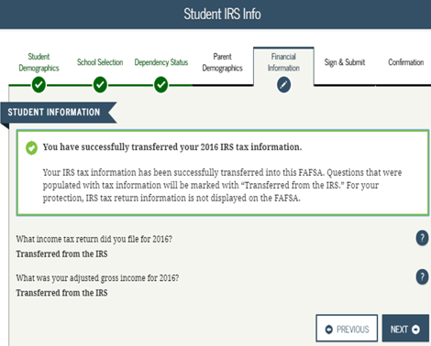
Transfer IRS
1040 tax info.
To FAFSA
Form online
2017
2017

Slide 15
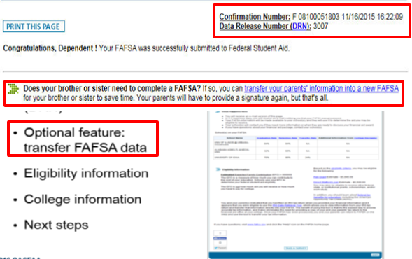
Confirmation Page & Transfer to New FAFSA

Slide 16
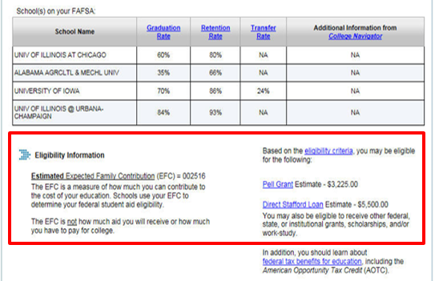

Slide 17
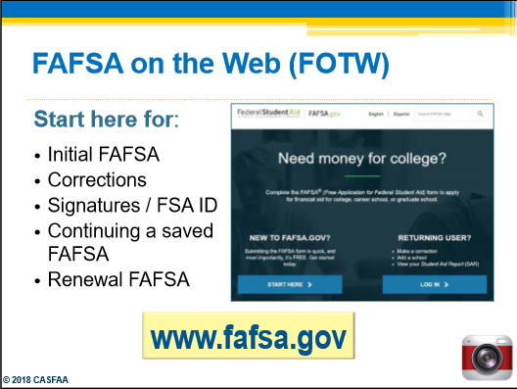

Slide 18
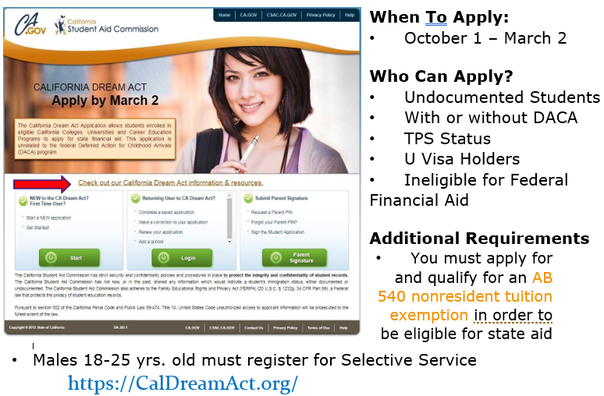

Slide 19

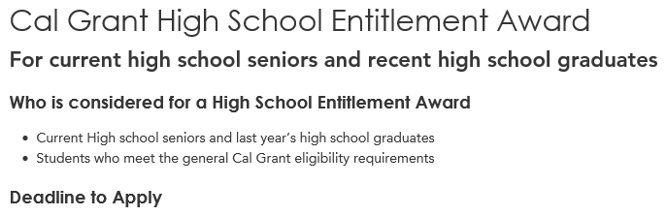

Date to Apply
  October 1st, 2018 to March 2nd, 2019
How to Apply
  The local high school already submitted the HS senior the GPA to the California Student Aid Commission (CSAC) by March 2nd
  HS senior completes a Free Application for Federal Student Aid (FAFSA) or CA Dream Act Application (CADAA) by March 2nd
  Create an account at WebGrants for Students after you submit your FAFSA or CADAA for your award status mygrantinfo.csac.ca.gov
Once you submit your completed FAFSA/CADAA and High School GPA you will be considered for the appropriate Cal Grant award based on GPA, financial need, and college of attendance.

Slide 20
What is Financial Aid?
Financial Aid is money that is:
      Granted
      Paid
      Borrowed (Loaned)
By the Federal or State government, college or private scholarship to help you pay for school.

Slide 21


Most of you know when submitting GPA’s for your current HS seniors you will only use completed coursework from the 10th grade and the 11th grade and summer school following those two grades. 9th grade coursework is never included and obviously you won’t include any 12th grade coursework because students are still in that academic year.
Acceptable GPA’s are unweighted and calculated using a 4.0 GPA scale.
No 9th grade or 12th grade GPA’s
Making education beyond high school financially accessible to all Californians.

Slide 22
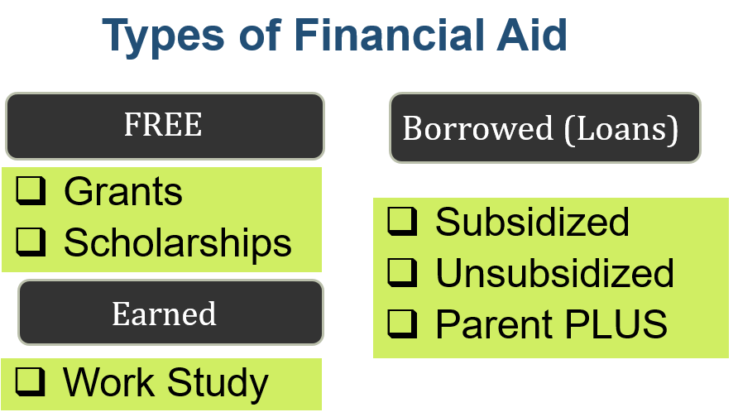

Slide 23
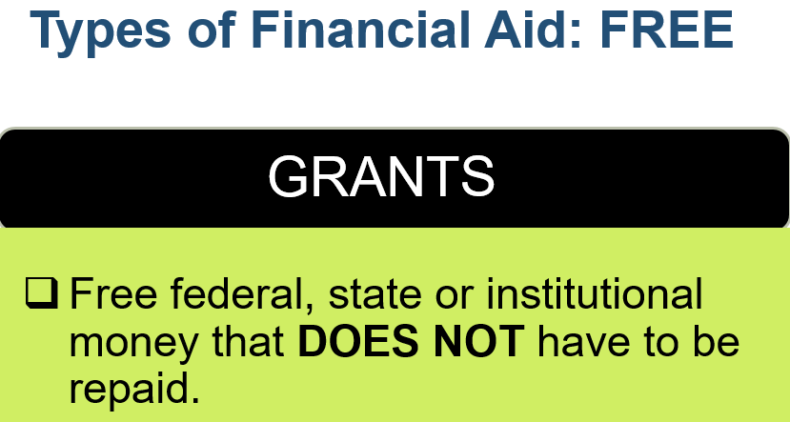

Slide 24
Types of Financial Aid: State Grants
CAL GRANT A
Low to middle income students who:
  Meet the income ceilings and asset ceilings
  Have financial need (low to middle income)
  3.00 High School GPA minimum
  Associate or Bachelor programs only within California
  Can only be used for tuition and fees
  Cannot be used at a Community College but can be in reserve for up to two years until student transfer to a university
CSU | UC | Independent | For Profit
$5,742/year | $12,630/year | $9,084/year | $4,000/year

Slide 25
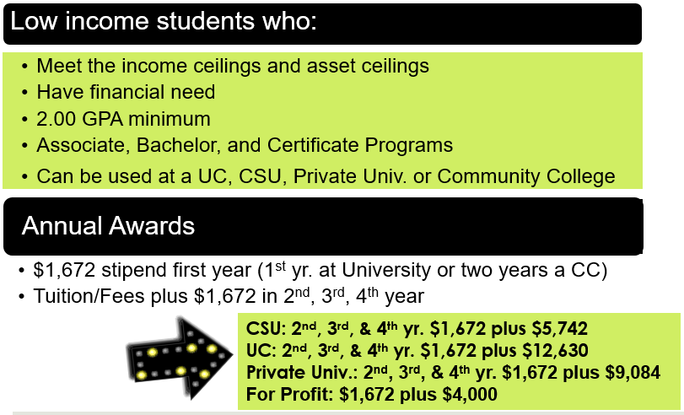
CAL GRANT B

Slide 26
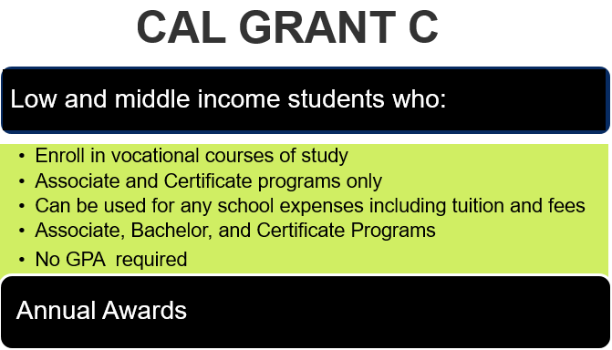


Slide 27
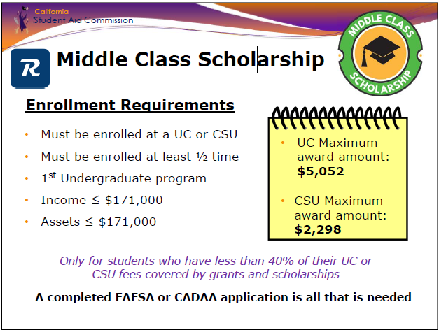

Slide 28

The government provides you money for school:
  Awarded to undergraduate students
  You can receive the Pell Grant for a maximum of 12 semesters or 6 years
  Award depends on your financial need, cost of attendance, full or part-time status, etc…
Award amounts for 2018-2019 is up to $6,095

Slide 29

Federal Supplemental Educational Opportunity Grant (FSEOG)
A grant for undergraduate students with exceptional financial need who also qualify for the Federal Pell Grant
  Apply early: Students with the lowest expected family contributions (EFCs) will be considered first
  Grant is administered directly from the financial aid office at your college/ university
  Not all schools participate
Award amounts for 2018-2019 vary from $100 up to $4,000 a year

Slide 30
Teacher Education Assistance for College and Higher Education (TEACH) Grant
For undergraduate, post baccalaureate, or graduate students who are enrolled in programs designed to prepare them to teach in a high-need field at the elementary or secondary school level
  Must agree to serve for a minimum of 4 years (within 8 years of completing the program for which your received the grant funds) as a full-time teacher in a high-need field in a school or educational service agency that serves low-income students
  Must attend a participating school and meet certain academic achievement requirements
  Failure to complete teaching service commitment will result in grant being converted to a Direct Unsubsidized Loan for repayment.
Award amounts for 2018-2019 vary from $100 up to $4,000 a year

Slide 31

Overview:
  Part-time employment while you are enrolled in school
  Administered by schools participating in Federal Work Study Program
  Available to full-time or part-time students
Where can I work?
  On or off campus (at some colleges)
  Bookstore, Starbucks, Library, Recreation Center
  Special Programs (Talent Search, Upward Bound, etc..)

Slide 32

Examples of Work-Study jobs:

Slide 33

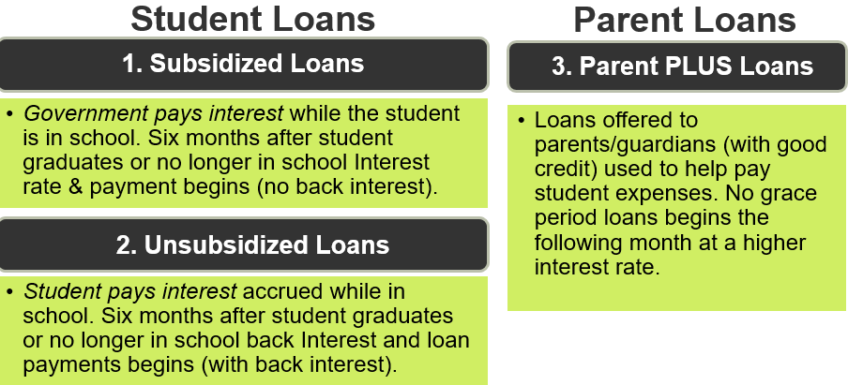

Slide 34
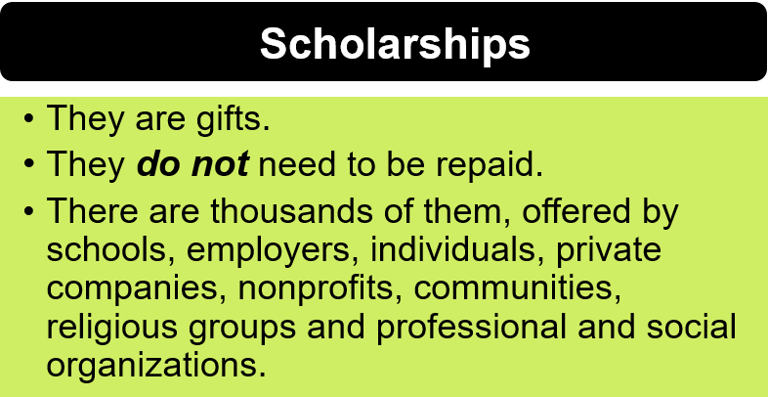
Type of Financial Aid: FREE

Slide 35
Scholarships
  Money you do not have to repay, usually based on the student’s skills, interest, area of study or scholastic performance
    Athletic, musical, or other special talents
    Community Service
    Good grades
    High test scores
  Beware of scams
www.fastweb.com
www.hsf.net
www.gmsp.org – Gates Millennium
www.coca-colascholarsfoundation.org
www.latinocollegedollars.org
www.unitedwayoc.org/sage-scholar-program
Contact the Career Center Coordinator or
Counselor for more scholarships

Slide 36
What you will need to get started!
2017 Tax Return (1040, 1040A or 1040EZ)
2017 W-2 Forms
Soc. Sec.# for parents/students (if applicable)
Marital status (parents & students)
Date of marital status (parents)
Permanent Resident card (if applicable)
Parents date of birth
Parents educational level
Students CA driver’s license number

Slide 37
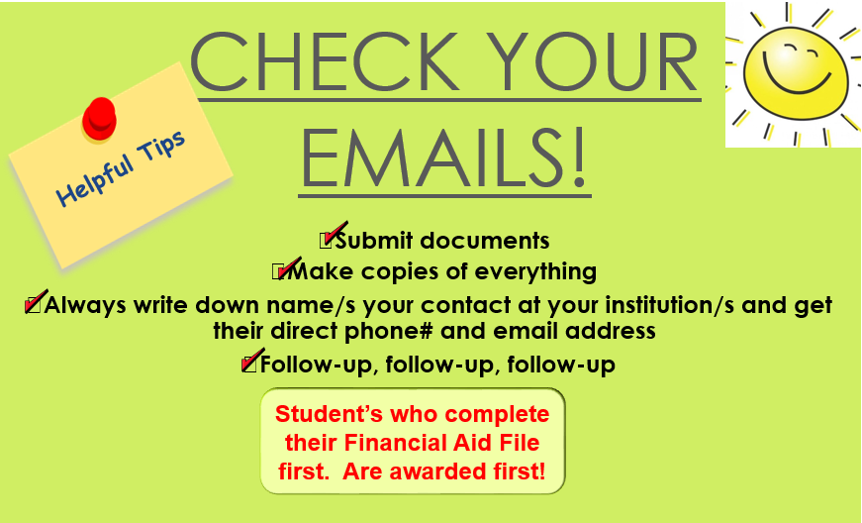
LAST STEP

Slide 38

  Victor Castro Room A-105
  High School & (714) 628-4808
  Community Outreach castro_victor@sccollege.edu
  Santiago Canyon College – 8045 E. Chapman Ave., Orange, CA 92869
Questions?

Slide 39
www.sccollege.edu

