Slide 1
Why do I feel like someone is watching me? Companies targeting and tracking you online
Presented by Mr. Theune with oodles of help from comonsensemedia.org

Slide 2
If you sold lemonade would you prefer…
To set up a lemonade stand on a random street and try to sell lemonade?
Know which street has the people who are really thirsty and love lemonade?

Slide 3
Targeting and Tracking Users Online: How online companies know what to sell to you
Amazon was one of the first companies to track and target users

Slide 4
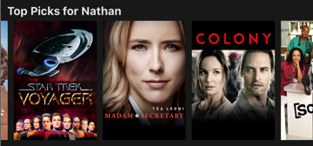
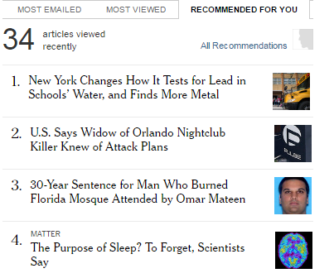
Targeting and Tracking Users Online: How online companies know what to sell to you
Soon other companies started using the same process (Netflix, Pandora, New York Times, etc):

Slide 5
How do the companies track your information?

Slide 6
How does online targeting and tracking make you feel?
Go to this link: https://answergarden.ch/430400

Slide 7
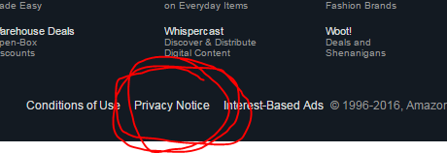
Let’s check out the Amazon Privacy Policy:
Go to Amazon.com
Click on the Privacy link at the bottom of the page

Slide 8
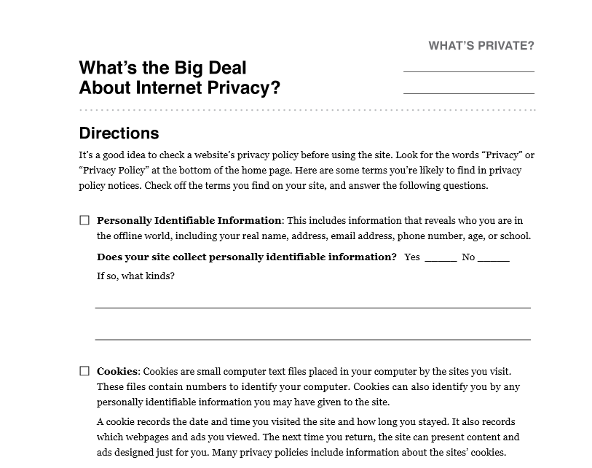
Work with a partner (or two) and answer the questions
Let’s try creating and Sharing a Google Document
http://tinyurl.com/zurvfka
Notes:
Use a deck of cards to get people matched up (Sevens with sevens, queens with queens)

Slide 9
Three Questions about Targeting and Tracking:
What do you think are the companies’ goals in tracking your information?
What do you think of tracking and targeting?
Do you think it is okay for companies to collect information about you?
Notes:
Tracking allows companies to target them with personalized content, usually to tailor their experience on the website or to deliver advertising aimed at them
Some students may believe that this is an invasion of their privacy or makes them feel uncomfortable; others might find that personalized information is useful to them or makes them feel special
Opinions may vary

Slide 10
What are Cookies? (Besides Delicious:)
Cookies are data files stored on computers when people visit certain sites, which companies can use to identify repeat customers and personalize visitor’s experiences

Slide 11
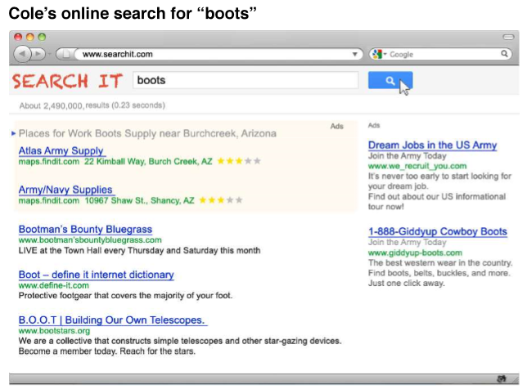
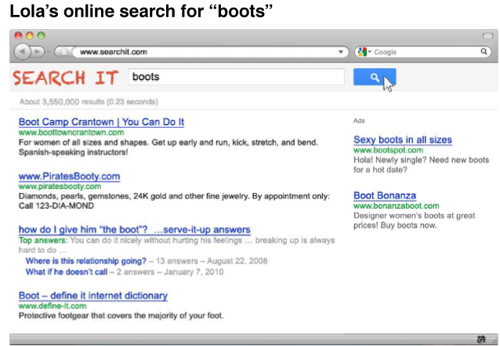
How do cookies affect your experience online?

Slide 12
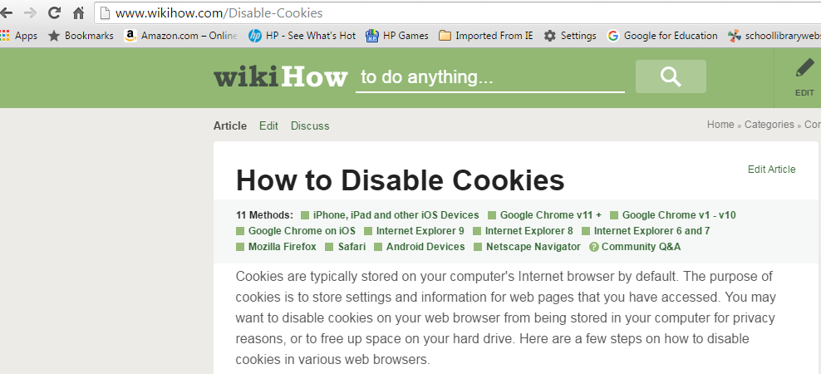
How to Disable Cookies-Let’s Try It!
http://www.wikihow.com/Disable-Cookies

Slide 13
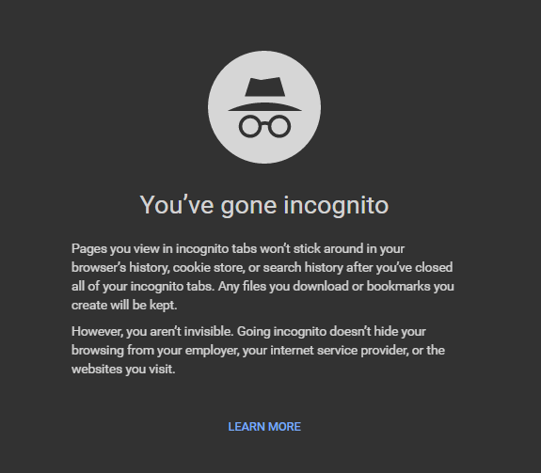
Go online “InCognito”
From Wikipedia: "incognito mode" is a privacy feature in some web browsers to disable browsing history and the web cache. This allows a person to browse the Web without storing local data that could be retrieved at a later date.

Slide 14
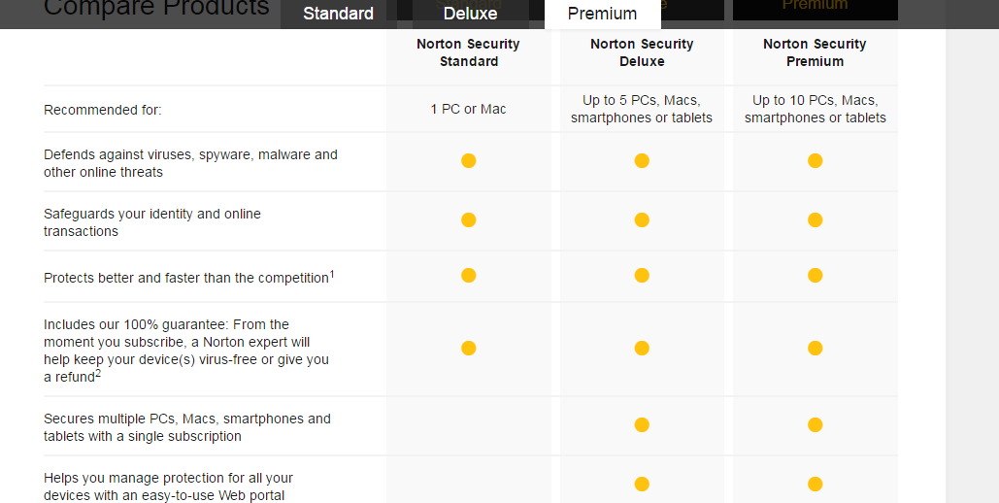
Antivirus Software
Norton Antivirus: http://us.norton.com/
Clark Howard (Consumer Advocate):
http://www.clark.com/clark-howards-virus-spyware-and-malware-protection
Offers free spyware/virus protection

Slide 15
How to Protect your Data
1. Don’t provide data (email addresses) to mailing lists unless you need to do so (or create a fake one)
4. Disable Internet Cookies
2. Limit the number of times you click on ads
5. Examine privacy policies
3. Avoid “too good to be true” products, deals and opportunities. Once they have your email address, they will sell it to other companies.
6. Install antivirus software that protects against spyware (programs that secretly collect your data).

